Slide 1
Sensing and Filtering Quadcopter Orientation
Dr. Steven Swanson
CSE176e/276e
swanson@cs.ucsd.edu

Slide 2
Basic Flight Algorithm
Receive target orientation (Done!)
Sense quad orientation (This Lab)
Adjust motor output to correct orientation (Next two labs)
Goto 1 (Done!)

Slide 3
Lab Tasks
Read values from IMU.
Use Arduino’s plotting tool
Run your serial port at max speed!!!
Read the pitch of your test stand with the motors on
Configure the filters on the IMU
Implement a complimentary filter in software.
Make it work in the presence of motor vibrations.

Slide 4
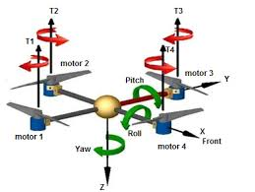
Pitch, Yaw, and Roll Angles
3 angles to specify an orientation
The AHRS library gives you the pitch and roll angles
We are only using ‘pitch’ in this lab.

Slide 5
Brief (and Incomplete) Explanation of High- and Low-Pass Filters

Slide 6
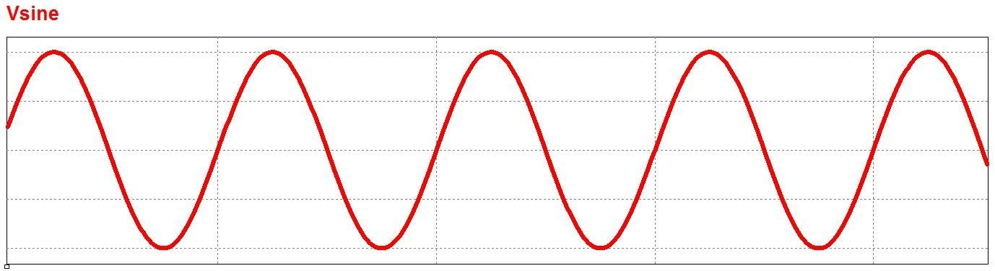
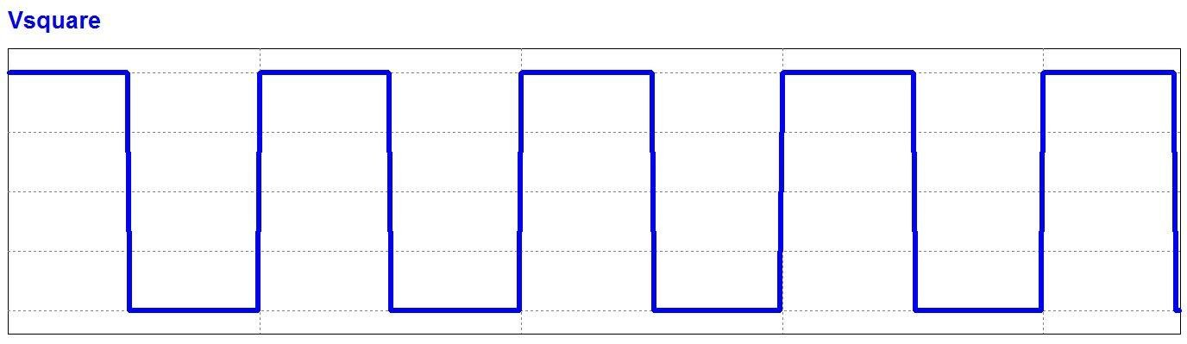
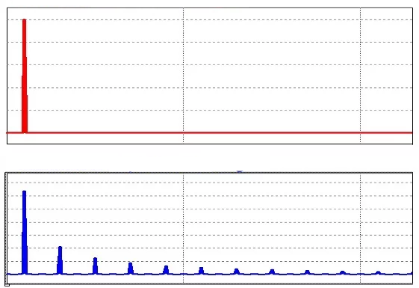
Signal and Signal Domains
Signals are just time-varying values (e.g., a pitch or roll angle)
Time domain
x-axis is time
y-axis is amplitude
Frequency domain
x-axis is frequency
y-axis is intensity
“High-Frequency” == Rapidly changing
”Low-Frequency” == slowly changing
Time Domain
Frequency Domain

Slide 7
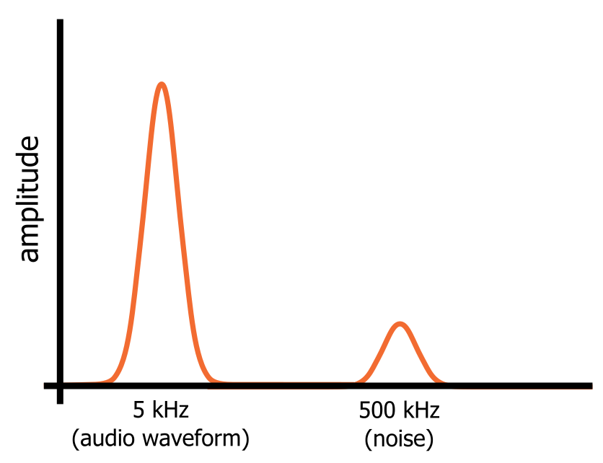
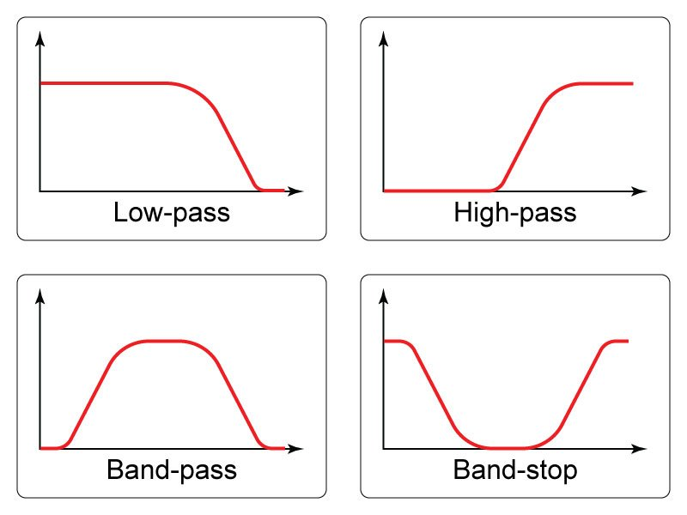
Signals Filters
Filters attenuate some frequencies in a signal
Low-pass filter attenuate high-frequencies
High-pass filters attenuate low-frequencies
Ex.: A low-pass filter can eliminate high-frequency noise

Slide 8
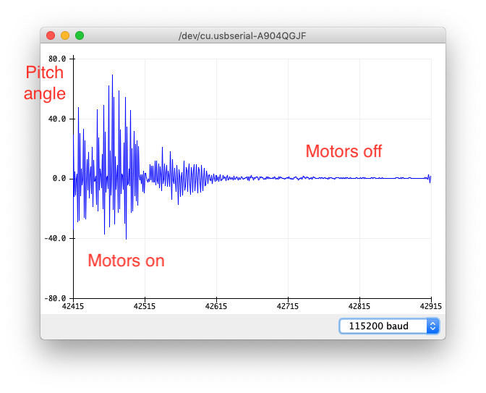
Accelerometer
Measure forces acting on the quadcopter along 3 axes
You can measure gravity’s direction using the the three axes.
Some trigonometry will yield Euler angles
Strengths
No drift
Good low-frequency performance
Weaknesses
Susceptible to vibration
Any acceleration (e.g., movement) will add error.
Poor high-frequency performance

Slide 9
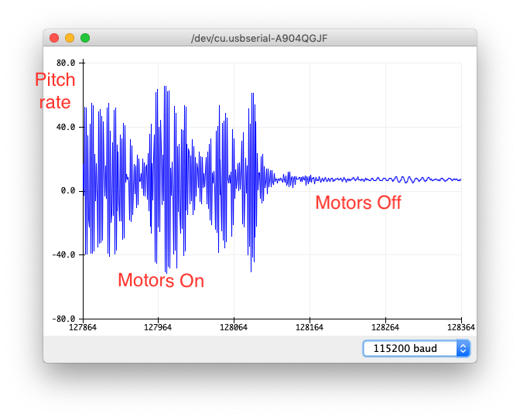
Gyroscope
Directly measures rate of change for pitch, roll, and yaw
Integrating will give you those angles (given a starting point)
“dead reckoning”
Strengths
Less susceptible to noise
Good high-frequency performance
Weaknesses
The integral will drift
Poor low-frequency performance

Slide 10
Complimentary Filter
Combine the best of accelerometer and gyro
High-frequency from the gyroscope
Low frequency from the accelerometer
The math is pretty simple
θ_{new} the new estimated Euler angle
θ_{old} the previous estimated Euler angle
dθ_{g}/dt gyro measurement
Δt Time since last gyro measurement
θ_{a} Angle from the accelerometer
C The “complimentary gain”
See the video for details
θ_{new} = C*(θ_{old} + Δt*dθ_{g}/dt ) + (1-C)*θ_{a}

Slide 11
Communicating With the IMU

Slide 12
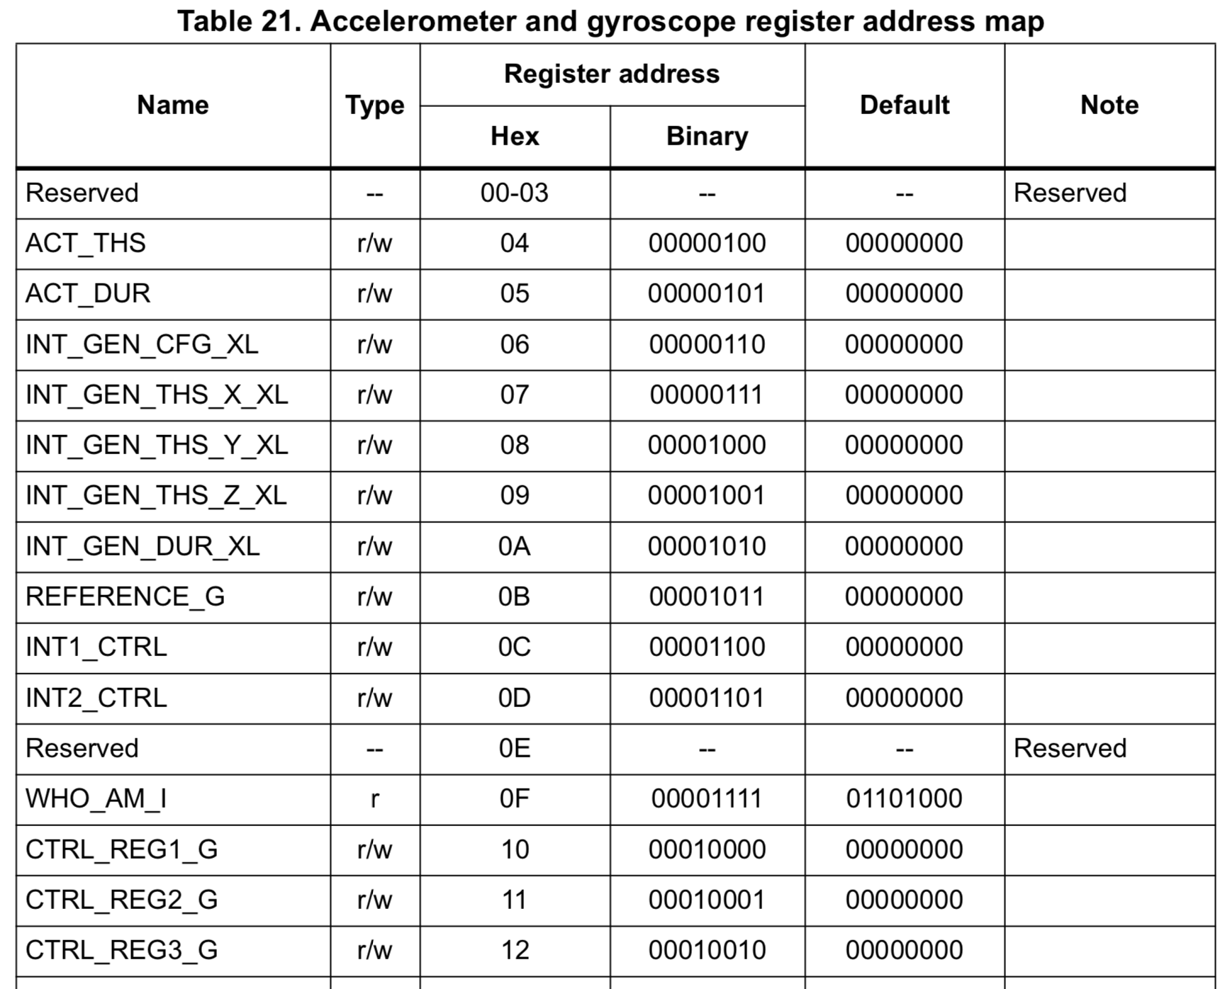
Reading and Writing “Registers”
I2C devices (and all modern, digital hardware devices) expose a set of “registers”
Each register has an address
Some are read-only
Some are read-write
Some are write-only
We read and configure the IMU by reading and writing to registers

Slide 13
Reading And Writing Registers with I2C
Each I2C device has an “I2C address”
8-bits
You configured one of these bits in your schematic
Arduino provides the Wire library for I2C communication
A little complicated – multi-byte access etc.
We won’t use this directly
QuadClass-LSM6DSO provides some convenience functions
void read8(boolean type, byte register_address)
void write8(boolean type, byte register_address, byte value)
Look at the library source code for details, if interested

Slide 14
Sensing and Filtering in Our IMU

Slide 15
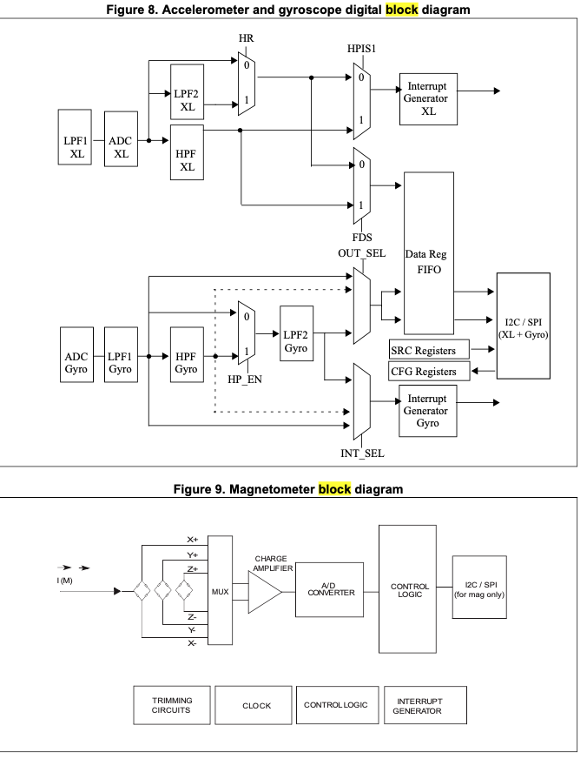
Our IMU: LSM9DS1
Our IMU is two I2C devices in one package
An Accelerometer+Gyroscope
“XL” and “Gyro” in the datasheet
A magnetometer
We aren’t using this.

Slide 16
Our IMU: LSM9DS1
An Accelerometer + Gyroscope
“XL” and “Gyro” in the datasheet
Both have a complex set of filters we can use.
ODR == Output Data Rate
How frequently you can read a new values from IMU

Slide 17
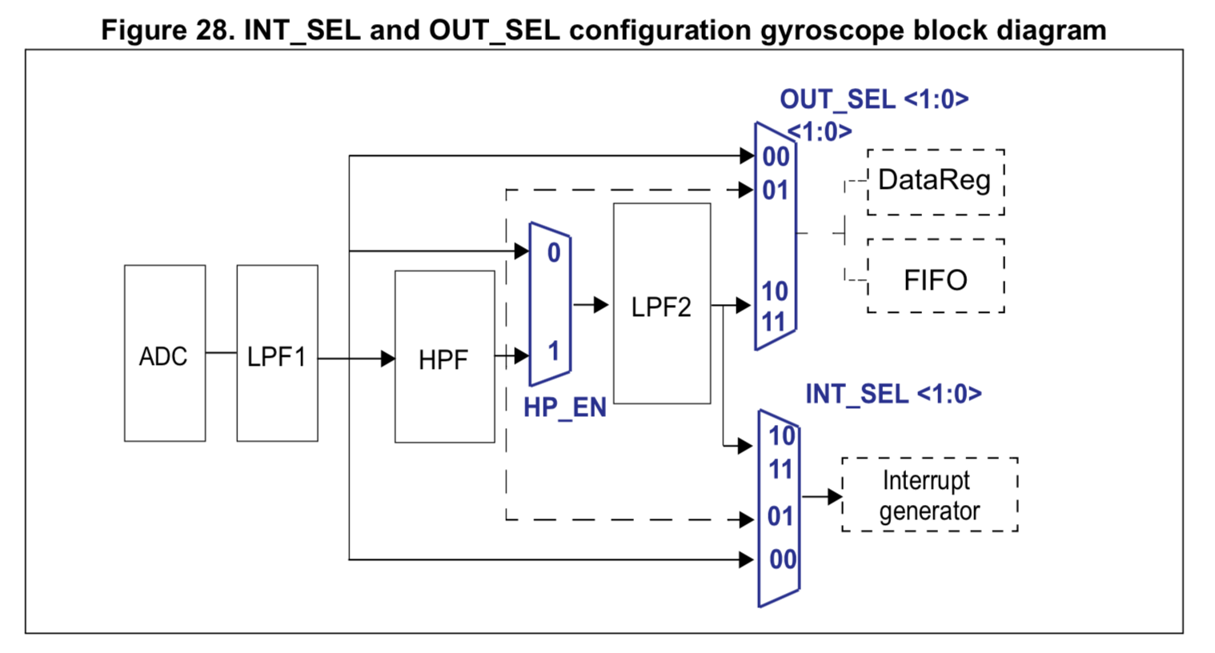
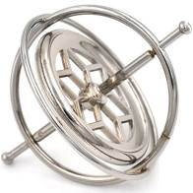
Gyroscope Datapath

Slide 18
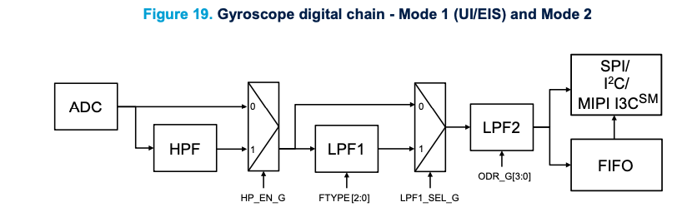
Gyroscope Datapath

Slide 19
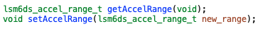
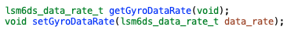
Gyroscope Filtering API
The QuadClass_LSM6DSOX object you used in the first hardware lab has methods to configure the gyro filters
Documented in
firmware/libraries/QuadClass-LSM6DSOX/QuadClass_LSM6DSOX.h
firmware/libraries/Adafruit_LSM6DS/Adafruit_LSM6DS.h
← Controls LPF1
← Controls HPF
← Controls LPF2

Slide 20
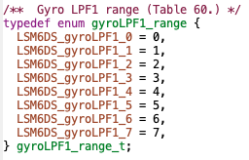
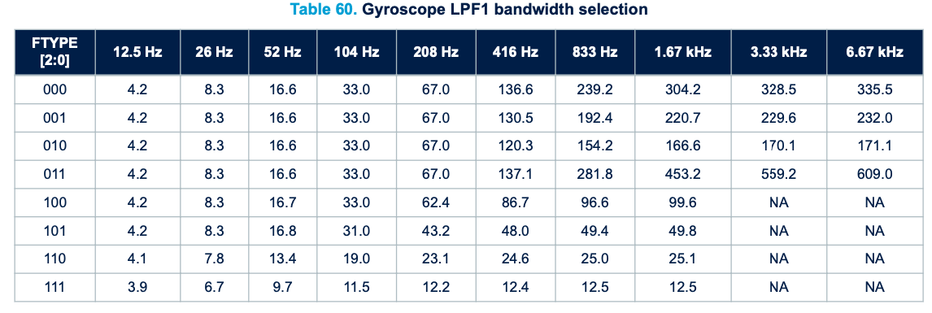
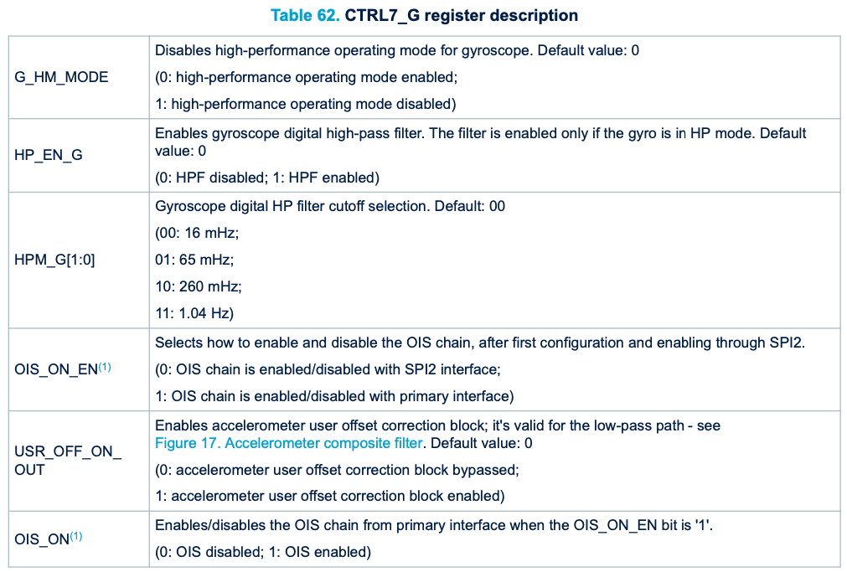
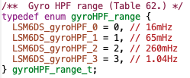
Example: setGyroLPF1()
ODR (set by setGyroDataRate())
Low pass cut off frequency
filter_range parameter
QuadClass_LSM6DSOX.h

Slide 21
LSM9dS1 Key Points
ODR – Output Data rate
How many readings per second does it the IMU take?
There are two ways to set it
One for just XL
Another if both XL and G are active
Key Sections
7.12, 7.13, 7.14, 7.24, 7.25
Reading data sheets is hard
You must read carefully, and thoughtfully.
It’s a bit of a puzzle.
This is part of what you’re learning in this class

Slide 22
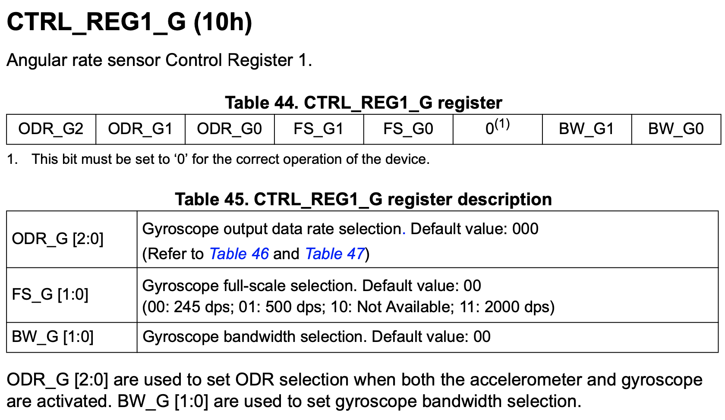
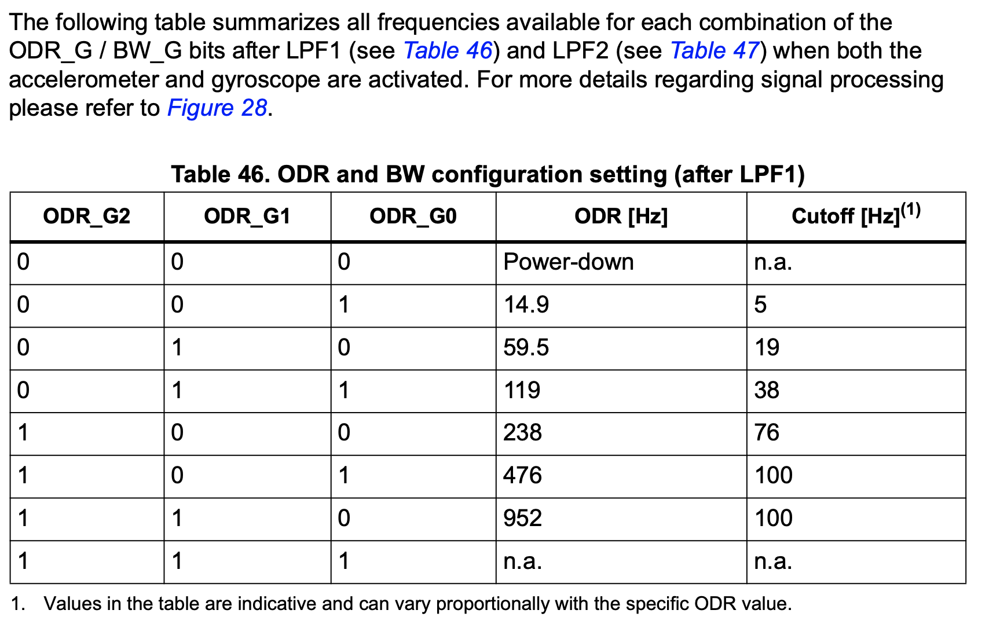
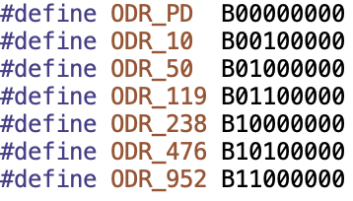
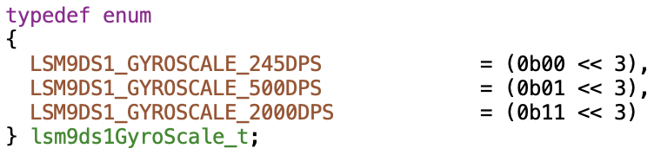
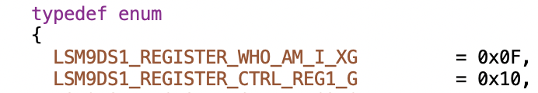
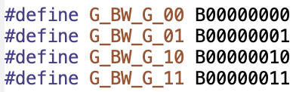
Example: IMU Datasheet Section 7.12
firmware/libraries/QuadClass-LSM9DS1/Adafruit_LSM9DS1.h
firmware/libraries/QuadClass-LSM9DS1/Adafruit_LSM9DS1.cpp

Slide 23
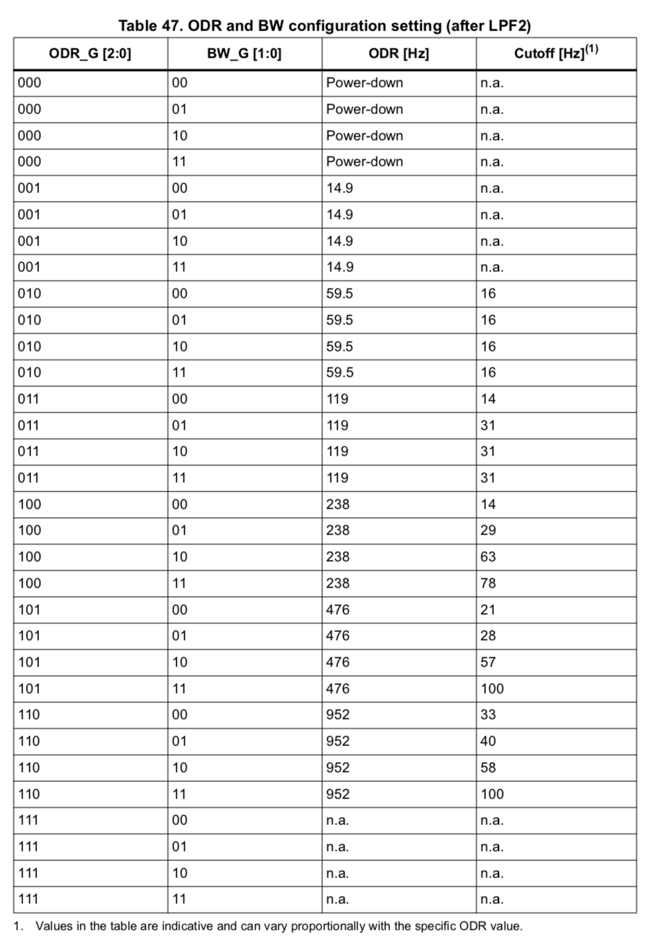
…
…

Slide 24
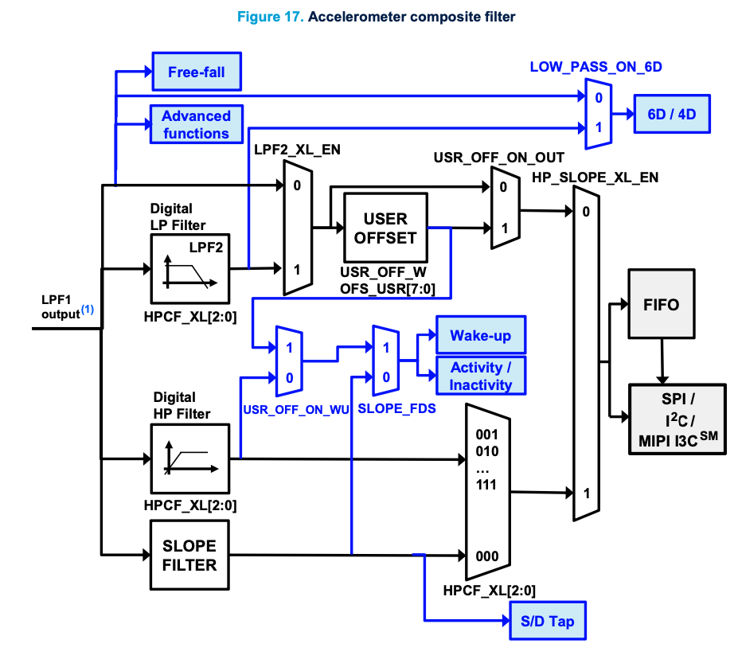
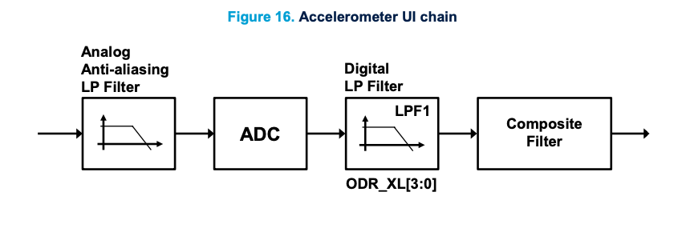
Accelerometer Filters

Slide 25
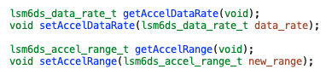
Accelerometer Filtering API
Methods
Documented in the same files
← Controls LPF1
← Controls LPF2 or HP Filter

Slide 26
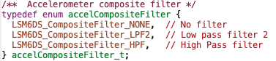
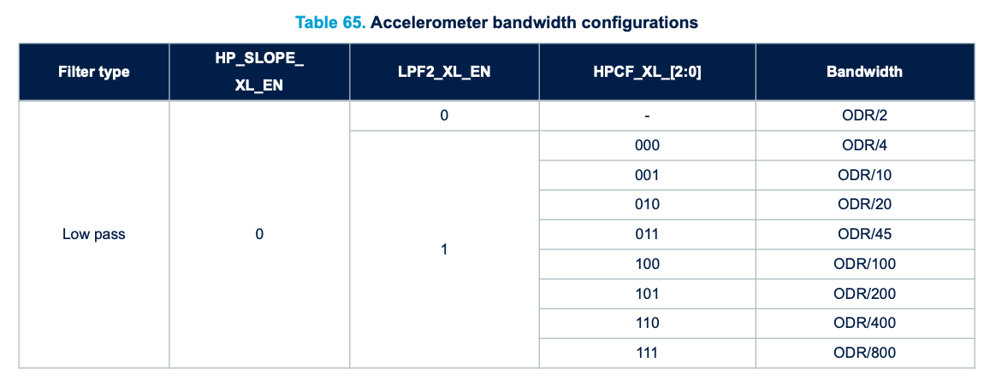
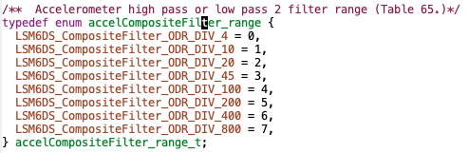
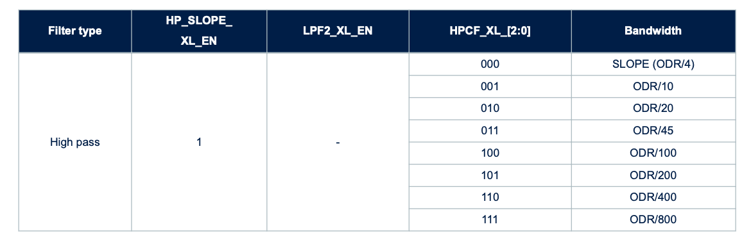
Example: setGyroLPF1()
ODR (set by setAccelDataRate())
QuadClass_LSM6DSOX.h
Low pass cut off frequency
filter_range parameter

Slide 27
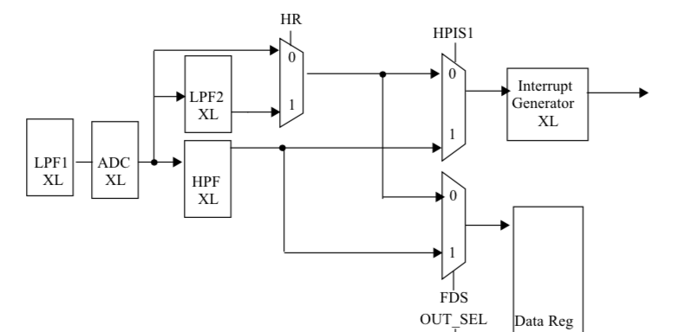
IMU Internal Accelerometer Filter

Slide 28
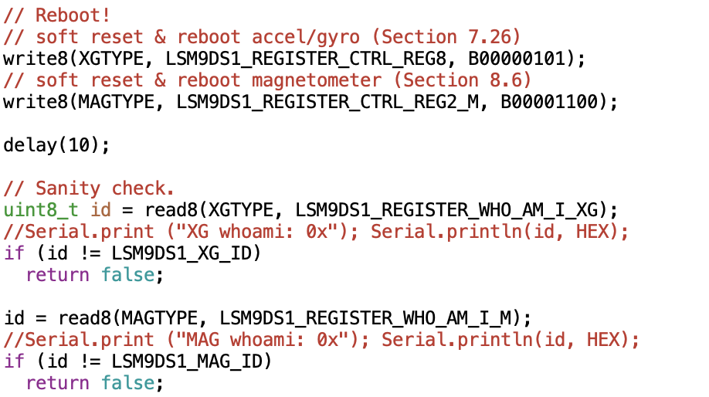

Slide 29
Filter Demo

Slide 30
Tuning
Two goals
Low noise
Low lag

Slide 31
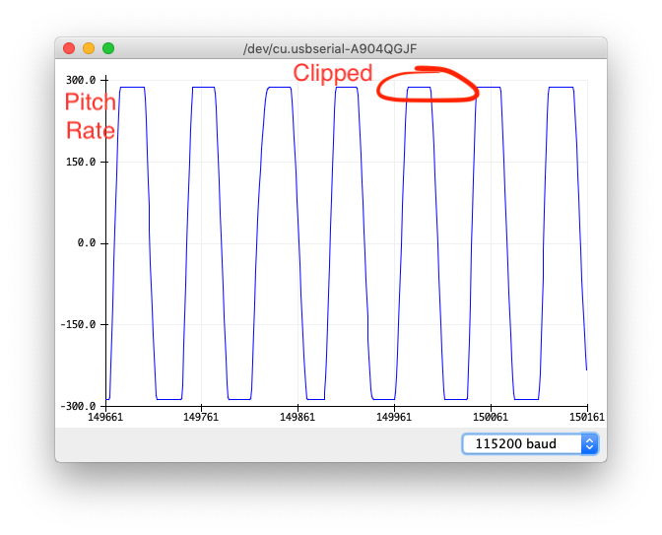
Gyro Clipping
Clipping occurs when the measured value exceed what the IMU can measure
Since we are integrating the gyroscope, clipping is especially bad.
Fix it by setting the resolution of your gyroscope.

Slide 32
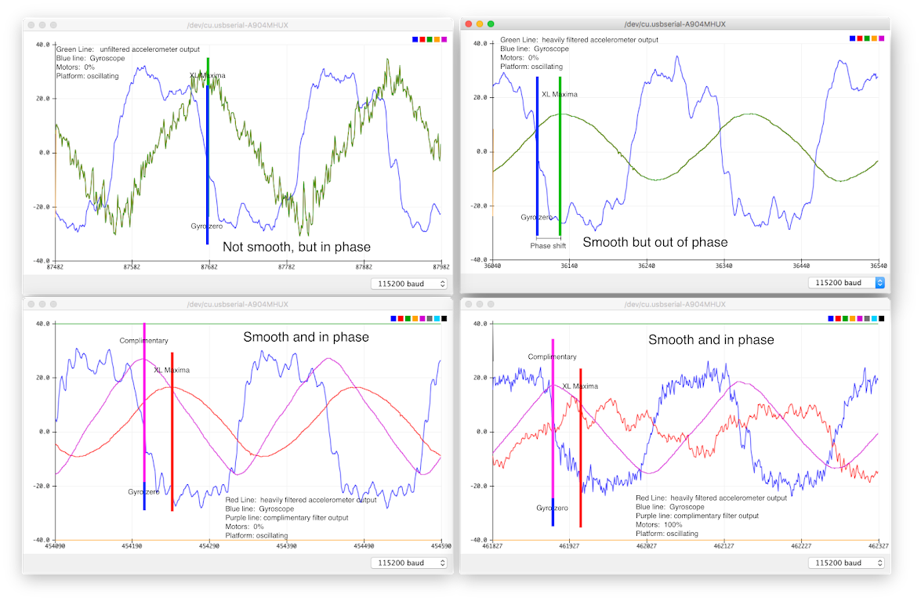
Gyro values are scaled down so the fit more nicely on the y axis.

Slide 33
Gyro values are scaled down so the fit more nicely on the y axis.

Slide 34
Gyro values are scaled down so the fit more nicely on the y axis.

Slide 35
Quadcopter Datapath
Use complimentary filter to blend acc. And gyro data
Pitch and roll
Complimentary gain should come from the remotse

Slide 36
The End

Slide 37
Next time
More details and updated code about writing to registers
More detailed discussion of XL datapath and filtering.
Slides about LP and HP filters.
These slides + assembly slides took about 60 min.
30 min of questions at the start.
Adjust complimentary filter demo, so it’s easier to get to C = 0

Slide 38
The PID Controller

Slide 39
To add
Discuss different ways they can control their quad
Pitch/roll -> rate of change of angle
Pitch/roll -> angle of attack
Pitch/roll -> velocity
Pitch/roll -> position
Throttle -> throttle
Throttle -> rate of climb
Throttle -> altitude
Discuss higher-order control
How to integrate GPS
How to integrate barometer

Slide 40
Note for Next Class
Demo
Integral windup
Tuning PID
Combine this lecture with the flight control software lecture

Slide 41
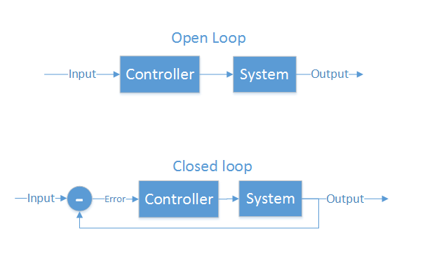
Control Theory
Making a physical system do what you want
“Open loop” and “closed loop”
Open loop - cannot see the system’s output
Motor controllers
LCD/LED/CRT screens
Closed loop - Can see output, make corrections
Autopilot
GPS guided munitions
Our quadcopter

Slide 42
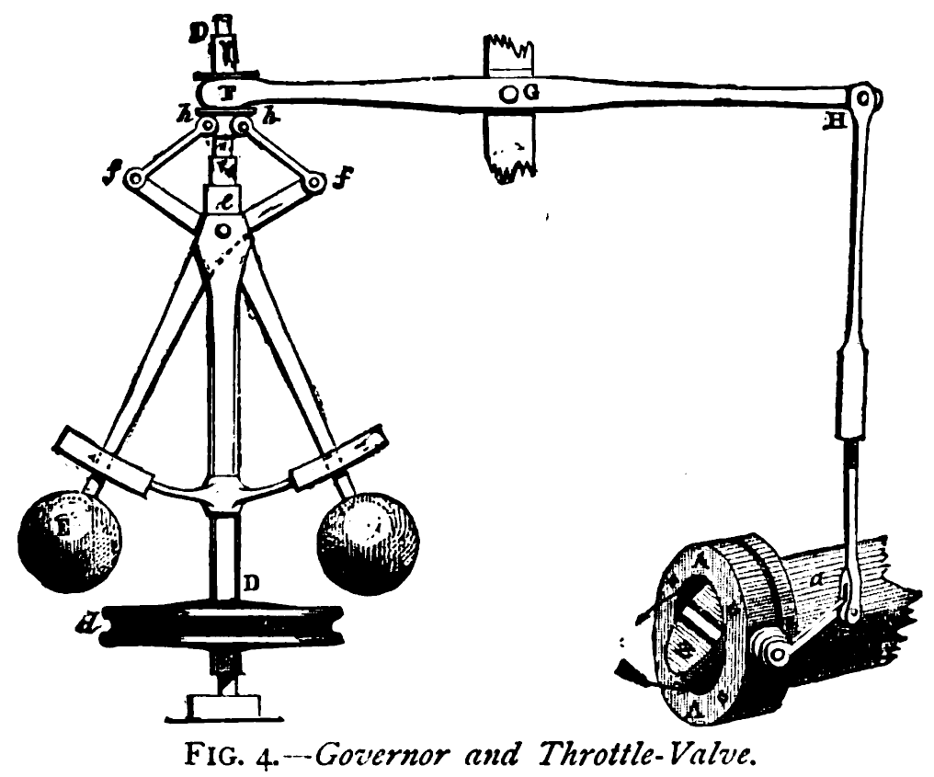
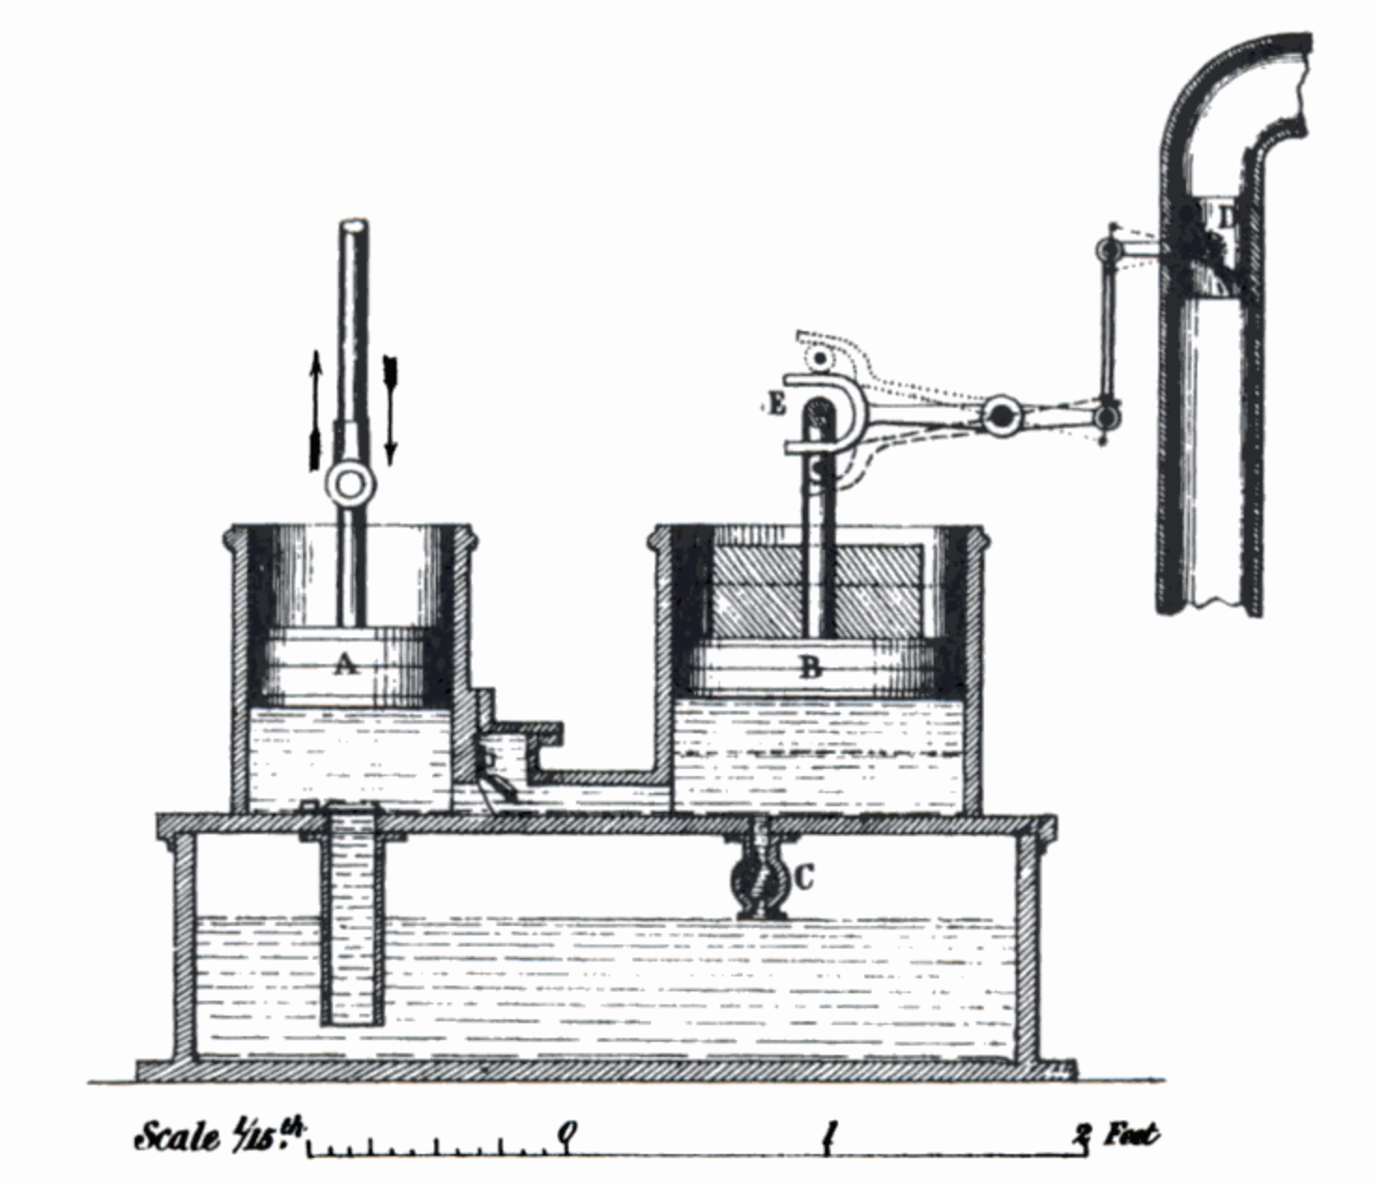
What is PID?
Make a system follow a set point
“Proportional, Integral, Derivative”
A brief history:
1788 - James Watt’s flyball governor (P)
1837 - Louis Molinié hydraulic regulator (PI)
1857 - H.N. Throop marine engine governor (PD)
1868 - Maxwell gives theoretical basis
1911 - Elmer Sperry, ship steering (PID)

Slide 43
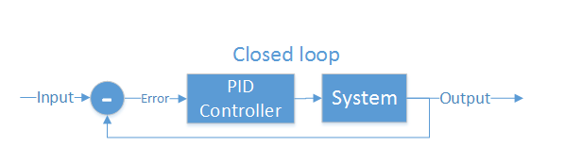
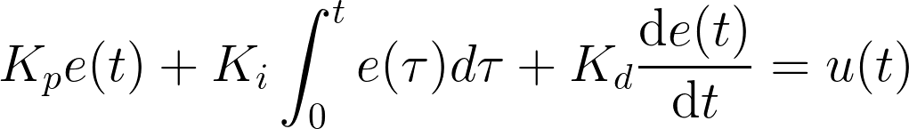
Closed loop control
PID is the most common closed loop controller
Proportional: Directly against error
Integral: Remembers error over time
Derivative: Dampens response to avoid oscillations

Slide 44
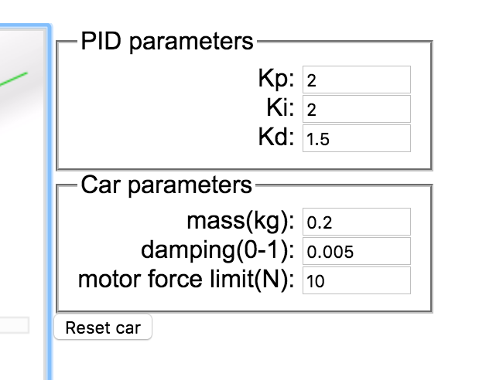
Example
https://sites.google.com/site/fpgaandco/pid

Slide 45
PID on the Quadcopter
3 separate controllers
PID set point is from user

Slide 46
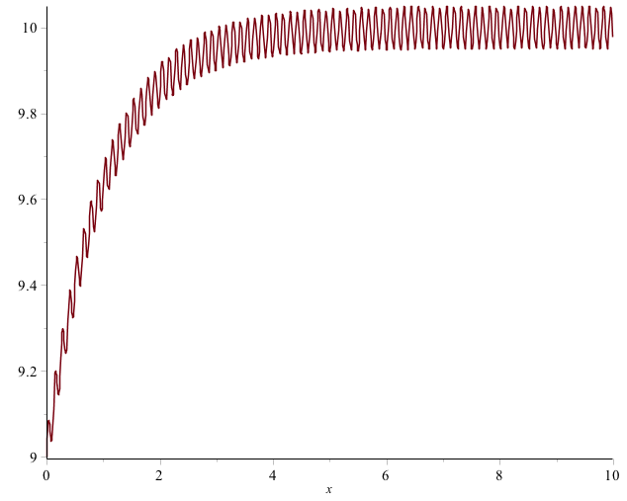
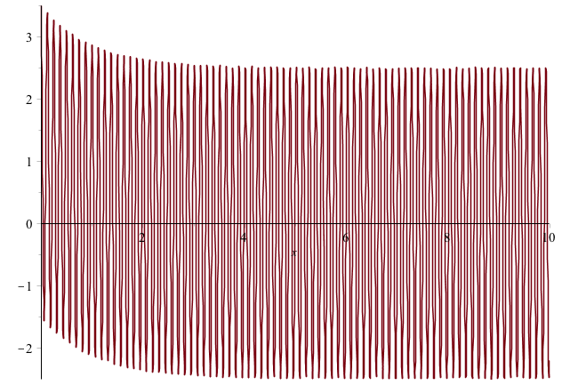

Pitfalls of PID
Integral term “Windup”
One solution: Exponential decay on integral (E.g., I = I/2 + error)
Derivative noise: beware of noise.
Solution: moving average of last several values. Or median of last several values.
Using the serial plotter in arduino to watch the D term.
3. Tweaking PID values
Tune P first, then D, then I.
Error term with vibration
Derivative term causes your system to go insane

Slide 47
Implementation
NOTES:
Where to get the derivative?
Integral windup
Pay attention to rate (hz)
Relative scale of inputs and outputs
Make sure timestep is consistent

Slide 48
How important in speed?
The key number is how many times/sec your PID loops (Hz)
The internet suggests > 100Hz (10ms/cycle) is necessary for stable flight.
My non-optimized code runs at 400Hz (2.5ms/cycles)
Action | Latency (ms)
Reading IMU | 7.360
analogWrite() | 0.012
analogRead() | 0.104
Integer PID (one channel) | 1.880 (531Hz)
FP PID (one channel) | 1.888 (529Hz)
AHRS getOrientation() | 1.860
rfWrite() 16 bytes | 0.812
Serial.write(“a”) | 0.906

Slide 49
Maintaining Stability
Multi-rotor aircraft require a closed loop controller
Sensors detect aircraft movement and orientation
Controller adjusts the power to motors to maintain desired location and orientation
Multi-rotor aircraft use a few sensors to maintain stability
Accelerometers (absolute pitch and roll)
Gyroscopes (changes in pitch, roll, and yaw)
The flight computer implements the control algorithm
Usually a proportional, integral, derivative (PID) controller implemented in software.
We will talk more about this later.
With PID controllers for pitch, yaw, and roll multirotor aircraft can achieve stable flight.

Slide 50
Tuning
Tuning PID is a bit of an art form.
Simple algorithm
Set P=I=D = 0
Increase P until it starts oscillating, reduce until it oscillates just a bit
Increase D to till it stabilizes pretty quickly
Increase I to fix offset
Increase D as much as possible with causing oscillation.

Slide 51
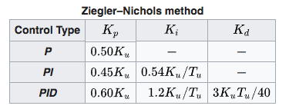
Tuning
Zeigler-Nichols method.
P=I=D= 0
Increase P until oscillations start. P is now at Ku, oscillation is at frequency Tu.
Follow the chart.
It’s important that your PID look incorporate its execution interval correctly.

Slide 52
Slides on Sensors
Accelerometer
Demo the data we get (3-axis accelerations)
Conversion to Euler angles. Show math.
Conversion to acceleration along x,y,z?
Maybe talk about coordinate systems?
Gyroscope
Demo the data we get
Other sensors
GPS
Barometer
Magnetometer
Temperature (for correcting measurements)
https://wiki.dronecode.org/_media/u01.imu_temperature_compensation_-_hessel_van_der_molen.pdf

Slide 53
New Slides on Filters
Noise
Calibration
Demo of noisy measurements
Demo of progressive improvements
Calibration
Tuning filters in the quadcopter
Tuning complimentary filter
Demo Drift from integrating gyroscope
Tuning moving average on euler angles
Demo of “good” pitch/roll angle measurements
Discuss magnetometer?
Calibration: https://github.com/kriswiner/MPU-6050/wiki/Simple-and-Effective-Magnetometer-Calibration
Heading calculations

Slide 54
Higher-order Navigation
Large multi-rotor aircraft can do more
Maintain geographic position
Maintain altitude
Follow an prescribed/pre-programmed path
More sensors required
Magnetometers (absolute yaw or heading)
GPS (absolute location and altitude)
Barometers (altitude)

Slide 55
Controlling Pitch
Pitch forward
More thrust to the rear
Less to the front
Pitch backward
Less thrust to the rear
More to the back

Slide 56
Controlling Roll
Pitch Left
More thrust to the right motor
Less to the left
Pitch Right
More thrust to the left motor
Less to the Right

Slide 57
Controlling Yaw
Rotate CCW
More thrust to the CCW motors
Less to the CW
Rotate CW
More thrust CW motors
Less to the CCW

Slide 58
Some Possible Configurations
Hexa +
Hexa x
“Plus”
“X”
Octa +
Octa x
“Octothorpe”
Y 6

